Slide 1
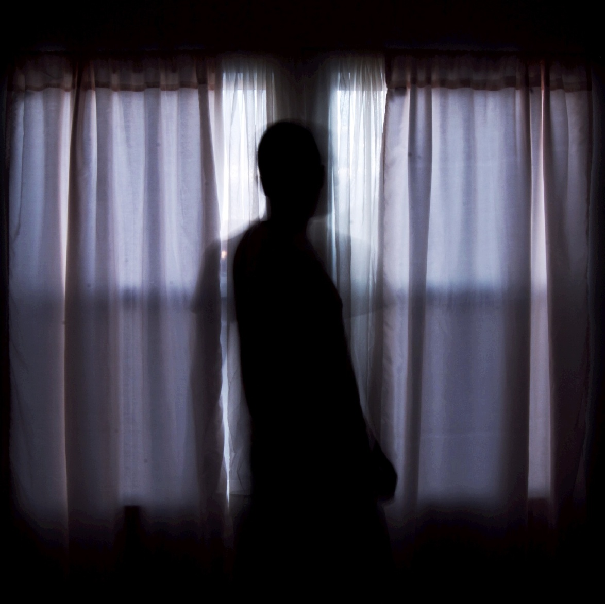
Mrs Craik (Dinah Mulock), "The Last House in C---- Street"
Sruthi Sundaram
Bolu Oriowo
Mica Cunningham
Anna Butcher
Taylor Wallpe
Maria Houser
(1856)

Slide 2
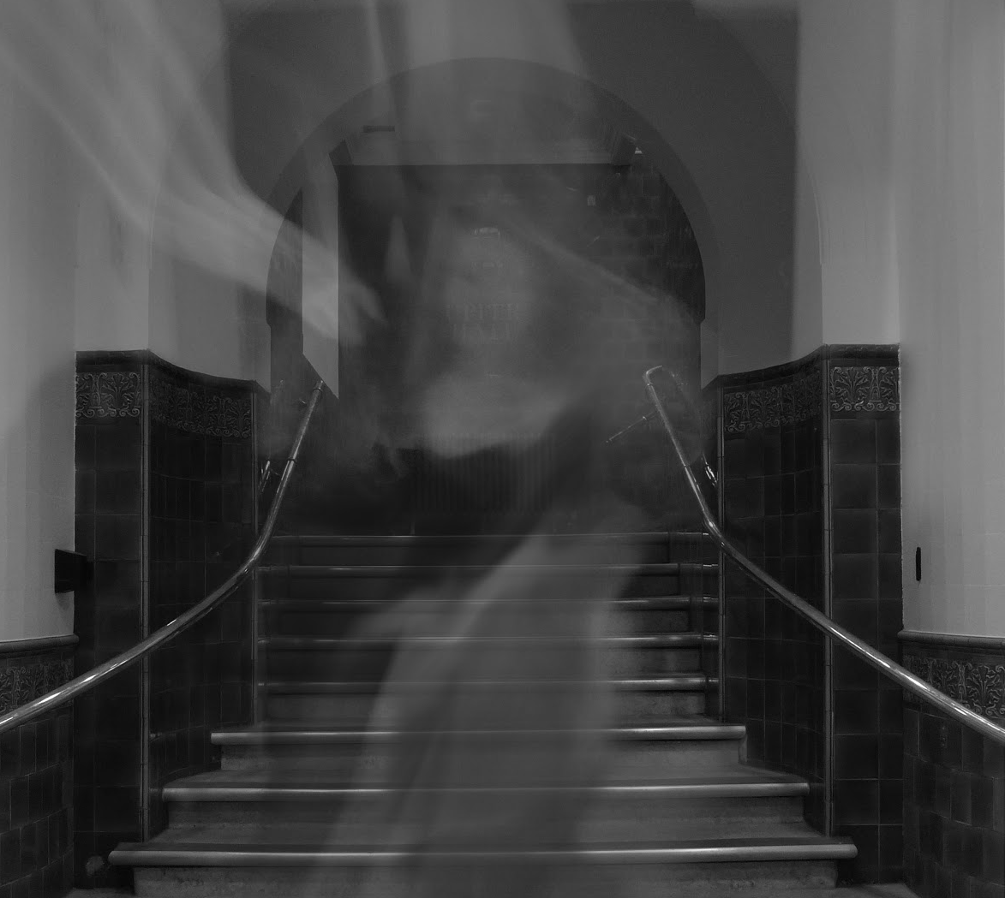
The Story
“ I am not a believer in ghosts in general; I see no good in them. They come -- that is, are reported to come -- so irrelevantly, purposelessly -- so ridiculously, in short -- that one's common sense as regards this world, one's supernatural sense of the other, are alike revolted.”
The story is a ghost narrative from the point of view of an aged Mrs. MacArthur as she dictates a event that occurred when she was 18 years old. She talks about going on a trip to London with her mother, father, and her lover Edmond Everest. Her pregnant mother feels sick and leaves Dorothy with her father and lover.

Slide 3
AND THEN
The Ghost Story begins…

Slide 4
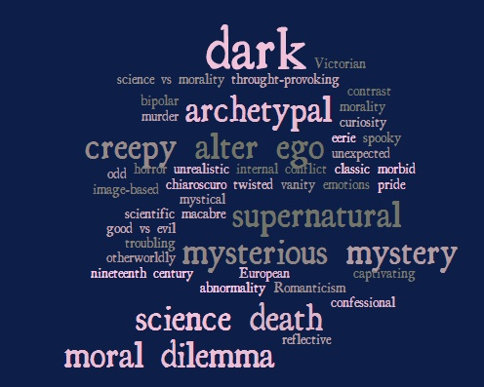
Gothic Themes
Gothic Themes
Gothic Themes

Slide 5
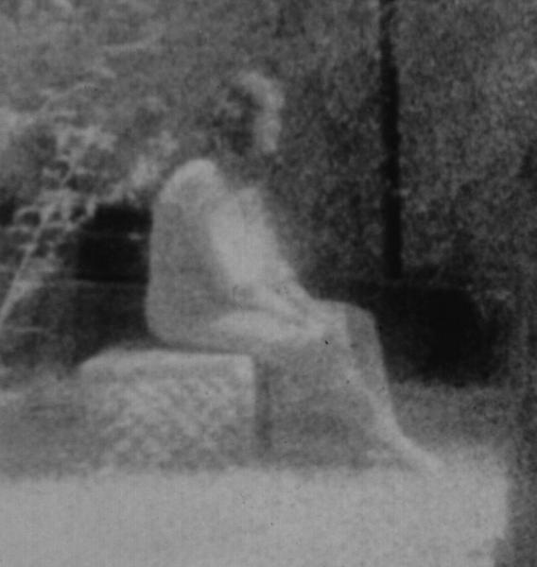
Unexplainable Events
“At that minute, distinct, clear, and unmistakable, like a person giving a summons in passing by, we heard once more the tapping on the pane. But nothing was seen; not a single shadow came between us and the open air, the bright starlight”

Slide 6
“'The next minute my maid and I both started up with a simultaneous exclamation.
'"Did you hear that?"
[…] there was no bird or bat or living thing about -- only the quiet summer night, the river, and the stars.”
Situational Irony
'"Dorothy, last night, as sure as I see you now, I saw your mother. […] "'Coming into the room just as she used to do in the bedroom at home, with the candle in her hand and the baby asleep on her arm."

Slide 7
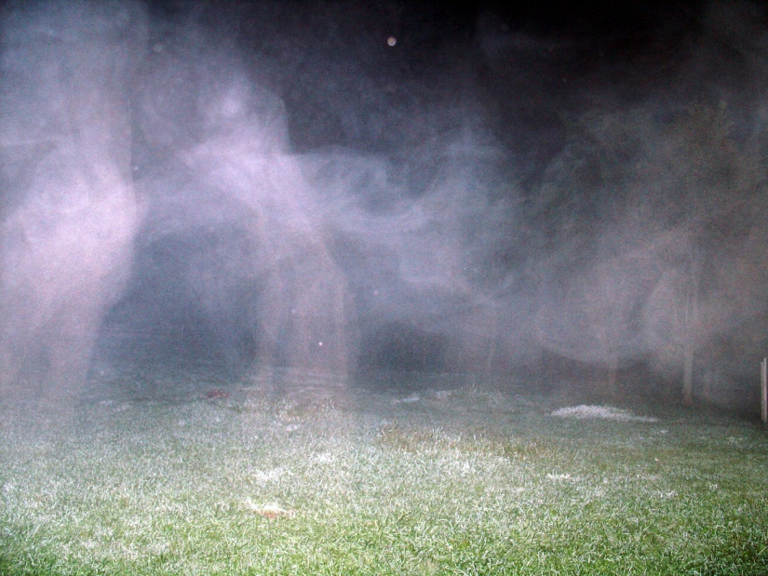
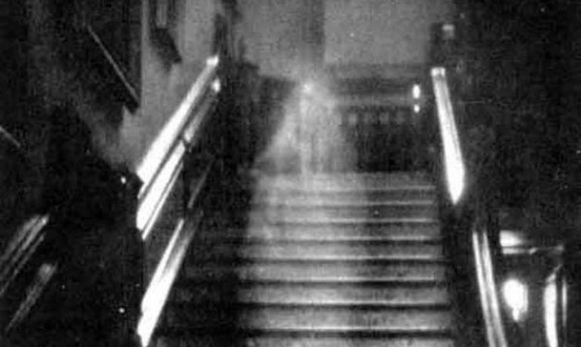
SUSPENSE
“'The next minute my maid and I both started up with a simultaneous exclamation.
'"Did you hear that?"
"'Yes, a bat flying against the window."
'"But the lattices are open, Mistress Dorothy."
'So they were; and there was no bird or bat or living thing about -- only the quiet summer night, the river, and the stars.”

Slide 8
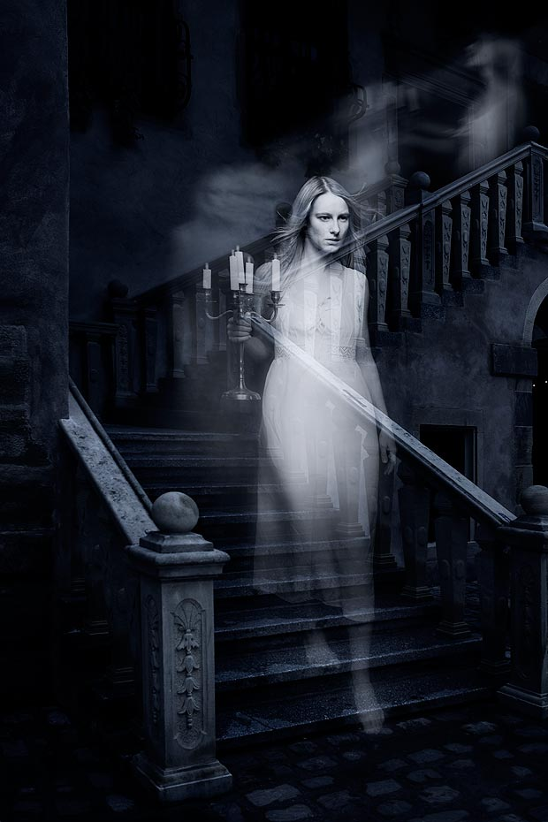
an atmosphere of ….Terror
'"Children," cried my father at last, "you are a couple of fools. Wait till you have been married twenty years. I must go to my Dolly. I know there is something amiss at home."

Slide 9
Supernatural
monsters, vampires, ghosts, werewolves, and such.
“The ghost, like Hamlet's, was 'an honest ghost'. From her daughter -- an old lady, who, bless her good and gentle memory! has since learned the secrets of all things -- I learnt this veritable tale. “ (frame narrator)
Strangely enough, no after events connected therewith -- nothing subsequent ever drove from my mind the vivid impression of this my first play. Strange, also, that the play should have been Hamlet. Do you think that Shakespeare believed in -- in what people call "ghosts"?'
VIDEO CLIP
0:55-3:30

Slide 10
How is this relevant to Victorian Life?
Ghost stories were popular in Victorian times because they explained many unexplainable events and offered a path for dissatisfied souls; many spirits that came back were troubled due to the way they died, or the depressing life they lived. When the person died, his soul was forever searching for the peace he never got in life...causing him to wander. This gave people something to talk about, stories to tell. Ghost stories also offered a venue to explore taboo topics such as ungodliness, evil mentalities, and vengeance.
RELEVANCE

Slide 11
And the ghost story continues…

Slide 12
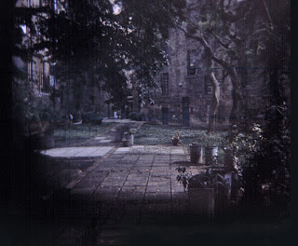
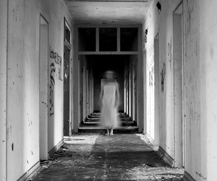
FOREVER…

