Slide 1
My Life Through Learning: The Value and Purpose Behind Community Engagement
By Sruthi Sundaram

Slide 2
What is Community Engagement?
Being “Engaged in the Community” is stepping out of the classroom, joining with peers, and going out into the community to help others. “Selflessness” is a large part of community engagement. As volunteers, we do not get paid for our work, nor do we expect payment. We serve simply to serve.

Slide 3
So why get involved?
Schoolwork day and night is BORING
More importantly, getting engaged in the community brings a sense of purpose in your life.
Understanding of why it is important to serve
Exposure to life outside of the classroom
Development of character: interacting with others in your community helps develop humility as well as gratefulness for the opportunities and gifts that you were given in life
MOST importantly, being engaged in the community teaches you that you are no better or worse than anyone else. The only reason that you are wealthier, or have more opportunities than the other person is because you happen to be luckier than them.

Slide 4
So what was my experience?
Bearcat Buddies
--Fran Larkin
Making Sense of Language Arts
--Linda Wihl
Peer tutoring
--private initiative

Slide 5
Bearcat Buddies
AWESOME experience!
Reese E. Price Academy—Two 2nd graders
----Reading and Math
Roll Hill Academy—Two 3rd graders (half hour each)
----Reading (prep for OAA)

Slide 6
Why are we here?
The purpose of the tutors’ involvement at Roll Hill Academy, is to help selected students gain the “push” they need to pass the Ohio Achievement Assessment (OAA) that they will take towards the end of the school.
So how do we achieve this?
How can tutors make a difference?
Mentee selection process
One-on-one mentoring

Slide 7
So what exactly did we teach?
A variety of basic reading topics such as use of graphic organizers, identifying context clues, prefixes/suffixes, formulating theme and relating it to author’s intent, how to read fiction
Observations about students’ performance: strengths and weaknesses

Slide 8
Improvements for program/curriculum?
Better mentee selection process
Better division of tutoring time
Learning reading topics through more relevant reading material
Field trips

Slide 9
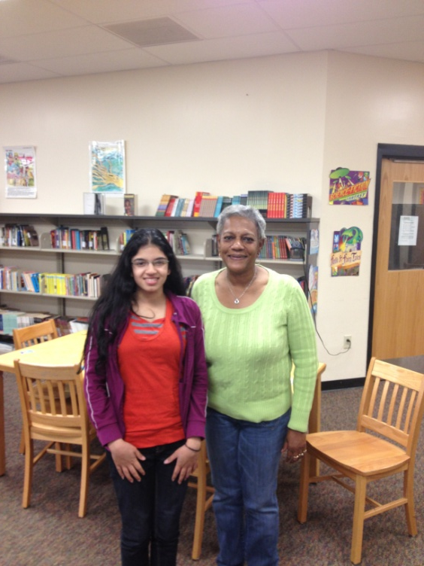
So what did I learn from this experience?
Patience, peer interaction, teaching skills, better understanding of my role in my community, relationship with my students, and amazing memories!

Slide 10
Making Sense of Language Arts
Rothenberg Academy—one kindergartener (1 hour)
Reading—understanding different letters, the words that contain those letters, writing those letters, interaction between letters, their sounds, etc.
Associative skills such as matching letters with words and then those words with pictures.
Interpretive skills—understanding the structure of a story and remembering plot.

Slide 11
So what’s so special?
Mentees are selected because of certain difficulties they have with communication. What is so intriguing about this program is that it focuses more on students who know the material but are unable to showcase their knowledge, whereas most traditional mentoring programs pick students who struggle with the material without considering expression.
“…uses multi-sensory techniques to build the neurology for language. Music, movement, art, touch etc. provide sensory links to strengthen the underdeveloped language center of the brain. There are also phonemic awareness and comprehension components in the curriculum” (Making Sense of Language Arts)

Slide 12
Class structure
Uniform each week with focus on one letter
Alphabet song
Story Circle
Letter Tracing
Picture Matching exercise #1: Letter → Word → Picture
Words that begin with the letter of the week
Review previous letters
Practice writing short words
Picture Matching exercise #2

Slide 13
Alternate Curriculum
Importance of reading to a child

Slide 14
How does this relate?
Sensory learning methods have proven very successful
It is of utmost importance to develop language skills early.
The program has had 80%-100% of its students begin at below grade level and end at above grade level in the course of one school year of mentoring.
Early language skills prevent behavioral and coping dysfunction
Suggestion for use of similar techniques in a more accessible tutoring program (such as Bearcat Buddies)

Slide 15
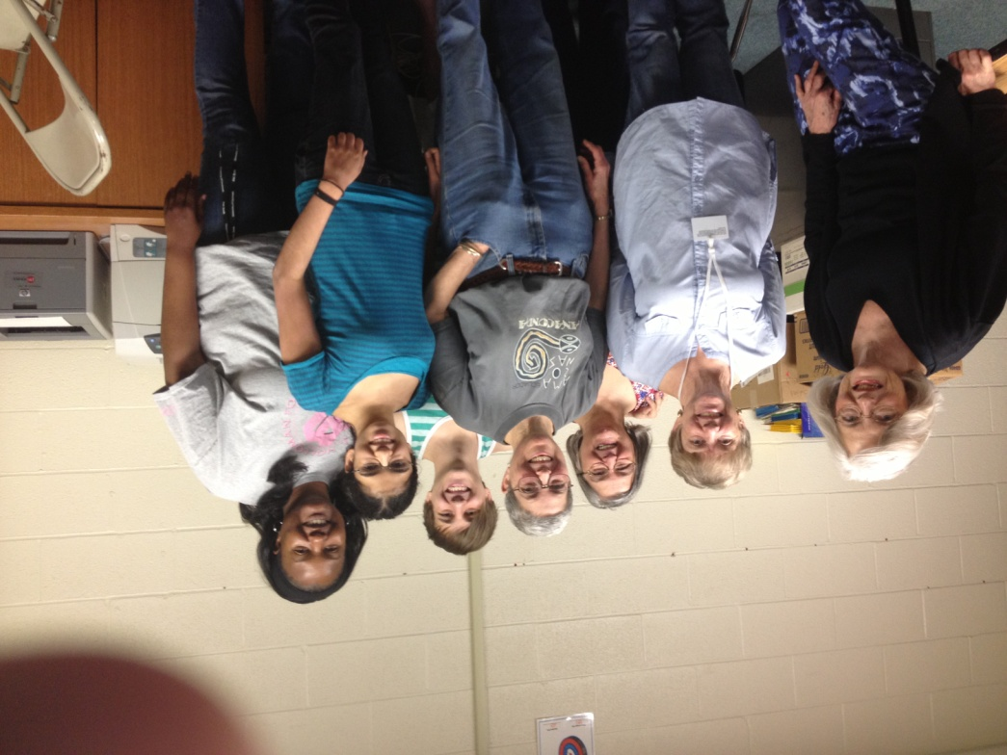
So what did I learn from this experience?
The sensory technique was a completely new mentoring style for me and took some training to become proficient in. My student was THE BEST student I have ever had; well-behaved, always focused, quick to catch-on. I saw a clearly visible improvement as the semester progressed and felt a real sense of accomplishment that I was able to make such a difference in my student’s life and future prospects.

Slide 16
Private Tutoring initiative
Different from other two programs—collegiate level work with completely different subject matter
Mentoring fellow classmate in the second semester portion of Gen. Chemistry
3-6 hours a week

Slide 17
How did I come by this opportunity?
Self-planned experience
Professor recommendation to another interested student
Much more independent
Curriculum varied based on student’s personal goals

Slide 18
What did I teach?
Joint learning
Activities included but were not limited to: homework, extra problems, reviewing concepts, connecting different topics, etc.
Subject matter: variety of topics covered in second semester Gen. Chemistry, including Intermolecular forces, kinetics, equilibrium, acids and bases, buffers, and metals
Accomplishments

Slide 19
How can such an initiative grow to a larger scale?
The learning assistance center (lac) and supplemental instruction (SI) programs provide similar services. However, these programs are often unknown to the masses of struggling students.
Better marketing—advertise throughout school through use of student organizations
Perhaps a volunteering program can be created through CCE for higher level assistance

Slide 20
What did I learn from this experience?
This was a phenomenal experience for me because it was so different from the other two programs I was involved, which were much more structured.
Peer-learning and teaching skills
Personal improvement in the subject matter that I taught
Creativity in teaching
More equal environment

Slide 21
So why is it all worth it?
Service
Engagement in the community teaches you to be more selfless as you look toward helping others without thinking about personal gain.
Engagement in the community gives you the opportunity to meet new people, make new friends, and learn more about life.
Engagement in the community teaches you patience, humility, and an understanding of your relationship with others around you.
Engagement in the community not only teaches you how to teach others but also to learn from them.

